Slide 1
Engineering Design Process (EP60042)
Topic: Digital renting Library and Offline Book Café
Group number: 18
Group members:
- Ankita- 20BT30003
- Kasis Lundia- 19PH20015
- Keerti Panchakshari Charantimath- 19MA20059
- Pallavi Bhaskar- 20AG10027
- Parv Maheshwari- 19MA20033

Slide 2
Introduction
Idea: To establish a B2C digital book rental service for hassle-free book access and combine it with offline book cafes to boost social interaction and enrich the reading experience for customers.
Challenges Faced by Book Lovers in Current Approaches:
Limited access to diverse books in remote areas
Space constraints from physical book storage
Reading can be a solitary activity, leading to feelings of isolation
Limited exposure to new authors and genres
Resistance to adopting digital platforms among traditional book lovers
Our solution:
Problem- Lack of time for physical bookstores
Solution- Digital book rental + offline cafes
Goal- Foster community and reading culture
By online renting and catalogues, users can see what all is available to rent, or buy in the book cafe near them. In this scattered market of renting, this initiative will focus on bringing a PAN Indian player.

Slide 3
Company owned cafés
Books shuffling in fixed intervals based on demand
Café 1
Café 2
Café 3
Café rents out book to customer in that area
Customer

Slide 4
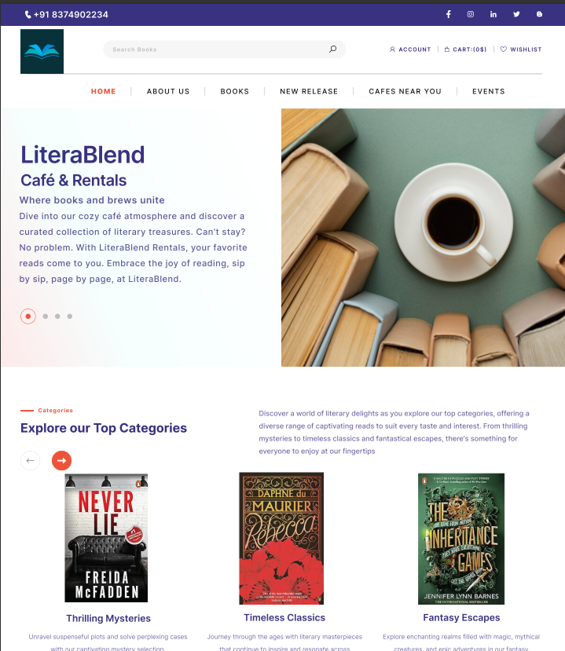


Website Prototype

Slide 5
Conclusion
Peer groups and online research show high anticipation for a blend of user-friendly digital platforms with welcoming offline spaces as it offers the following benefits:
- Convenience: Easy book access without the need to visit a store - Community Building: Promotes social interactions & relationships among readers - User-Centric Design: Prioritise user experience, resulting in delight for customers - Technological integration: Innovative technology improves operational efficiency - User Inclusivity: Anywhere availability promotes user inclusivity
The suggested solution has two major challenges which are: - Initial Investment: high set up expenses for online and offline infrastructure - Operational complexity: Balancing digital and physical processes necessities

